Slide 1
Virtualization at CSUDH
Dr. Ronald Bergmann
Associate VP for IT and CIO

Slide 2
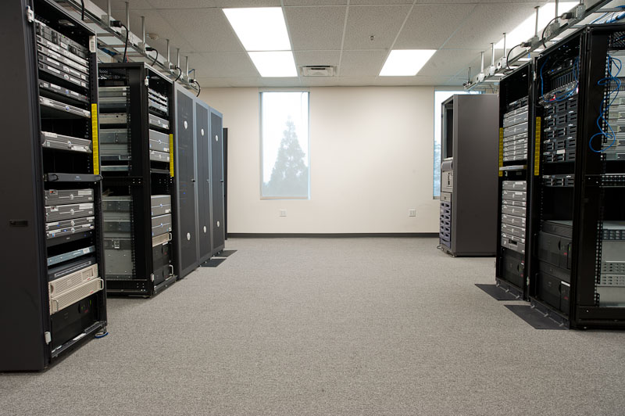
From this:

Slide 3
To this:

Slide 4
And finally this

Slide 5
Virtualization
www.umbc.edu/meec/docs/hartfordvmware.ppt

Slide 6
What is Virtualization
www.synegi.com/.../Server%20Virtualization%20Seminar%20Presentation.ppt

Slide 7
Highlights of Virtualization
Former model
Single OS image per machine
Hardware and software coupled
Conflicts when using multiple applications
We found most machines were at 10% capacity
Manage full images rather than data alone
Makes restoration of entire machine possible

Slide 8
Outcomes of Server Farm Virtualization
Reduce costs for server replacement
Formerly maintaining over 200 physical servers
Development of a robust platform to launch improved services to the campus
Mobile Labs
Virtual desktops
Ease of administration in software offerings

Slide 9
Outcomes of Server Farm Virtualization
Administration from anywhere, anytime
Increased disaster recovery thru replication
Reducing the carbon footprint of the campus
Reduction in costs of power
Reduction in costs for HVAC
Edison rebates to pay for equipment

Slide 10
Outcomes of Server Farm Virtualization

Slide 11
Data Center Redesign
Redesign of data center was a critical piece in beginning the virtualization efforts
Purpose to identify all servers and appropriately place them in firewall zones for maximum protection
Identified servers that were no longer needed and/or underutilized.
Developed security as we moved from physical to virtual

Slide 12
Data Center Redesign

Slide 13
Edison Site Survey
Edison inventoried all identified servers
Edison conducted a site survey at the close of the project to ensure all identified servers were removed from the network
Received $158K from Edison at the close of the project

Slide 14
Disaster Recovery Benefits
Complete systems – incl. virtual hardware, OS and applications – are encapsulated in a single file.
That entire file can be easily replicated to the DR site.
The process of recovery is reduced to powering on the VMs on the DR site.
DR site can be located in any geographic location that has connectivity

Slide 15
Disaster Recovery
www.synegi.com/.../Server%20Virtualization%20Seminar%20Presentation. ppt

Slide 16
Transformation
www.synegi.com/.../Server%20Virtualization%20Seminar%20Presentation.ppt

Slide 17
Desktop virtualization advantages
Desktops are an even more significant consumer of energy than servers
Over 500 million desktops in the world
With a thin client you can save about 70%, depending on what your PC looks like and what the thin client is.
The other major benefit is the time to replacement. You don’t need to replace thin clients nearly as often, thereby reducing your costs and e-waste that goes into manufacturing the desktops.
www.umbc.edu/meec/docs/hartfordvmware.ppt

Slide 18
Virtual Desktops
www.synegi.com/.../Server%20Virtualization%20Seminar%20Presentation. ppt

Slide 19
Questions?

